Slide 1
The View from 2114? Climate Change in the American History Survey
Roger Turner
Associate Fellow, Dickinson College
and Consulting Historian

Slide 2
The course: American History 1877-Present
Core intro class; taught everywhere; cultural diversity requirement
Lots of thematic flexibility, but coverage is important: gotta tackle many notable events
Obvious Challenge: How to talk about CC into a course about the past, when the worst effects are still in the future?

Slide 3
Foundation laid across semester
Gilded Age/Immigration: Dev. Mineral Economy
Andrews, Killing for Coal
New Deal: Government, Capitalism and Climate Variability
Worster, “Grassland Follies”
WW2: Meteorology Transformed
Turner, “Teaching the Weather Cadet Generation”
Cold War: Anthropogenic Global Change Possible
“Last Word: Barry Commoner”
Suburbization, Energy Crisis, Iraq Wars: Oil dependency and resistance to change
Jones, “America, Oil, and War in the Middle East”

Slide 4
Final Lecture: The View from 2114
Prefacing Discussion: What will historians in 2114 think was most important about early 21st c U.S.?
My Answer: Unwillingness of US gov’t to seriously try to prevent Climate Change.
So, here’s what a 22nd century history lecture might sound like…
[costume change?]

Slide 5
1. Intro: The Golden Age of Overuse
22nd c Public Memory (Survivor revival, Greatest Gatsby)
We’re fascinated by their carefree luxuriation in food, power, danger: fruit year round, bacon everywhere;
In Historical View: Destruction caused by quick profits and efficiency over sustainability
Overuse harms visible everywhere (RSIs, Tampa Bay Buccaneers 2013; constantly deepening wells) but sparked little political concern
Especially revealing: early 21c Am’s knew all about climate destablization (“Global Warming”), but did little about it.
Like Reconstruction: proper action could have prevented vast future misery

Slide 6
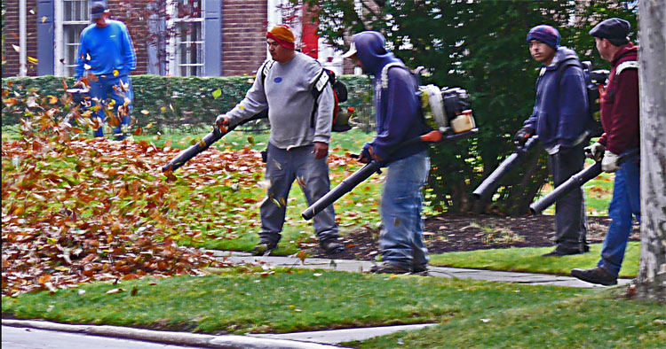
“Leaf Blowers”

Slide 7
2. How Did They Know?
[Brief Social History of Climate Science]
Well-Funded Scientific Elite oriented to research and knowledge creation…
Using Technoscience invented to project military power by envisioning the globe (WW2, Cold War)
Computers, satellites, global env surveillance network
But also in opposition to militarism: Sagan’s “Nuclear Winter” research in support of Nuclear Freeze
New forms of knowledge production: IPCC created; issued increasingly strident and reliable warnings

Slide 8
3. What Did They Know?
[Science-based predictions from IPCC, etc. with invented future events and sociopolitical responses]
Changing patterns of drought and flood
Predicted the collapse of climate dependent industries
Wine making; Skiing.
Increased Heat Wave danger.
Ocean acidification and the End of Seafood.
Decline of agricultural productivity.
Lower Economic growth

Slide 9
4. Why didn’t they act?
[Brief history of climate politics from Rio to People’s Climate March]
Many did try: Al Gore; near passage of a BTU tax in 1994; Activist groups and major rallies
Then common view: Technological Innovation will save us! (Note: most great 19/20c innovations used more energy, not less)
Political power of “Free Market Fundamentalism”: Wealthy interests create doubt about science to prevent regulation (Oreskes and Conway, Merchants of Doubt)

Slide 10
Bibliography
Thomas G. Andrews, Killing for Coal: America’s Deadliest Labor War (Harvard University Press, 2010)
Donald Worster, “Grassland Follies: Agricultural Capitalism on the Plains,” in Under Western Skies: Nature and History in the American West (93-105)
Roger Turner, “Teaching the Weather Cadet Generation: Aviation, Pedagogy, and Aspirations to a Universal Meteorology in America, 1920-1950,” in Intimate Universality: Local and Global Themes in the History of Weather and Climate (Science History Publications, 2006): 141-173.
“Last Word: Barry Commoner,” New York Times (Video). Oct 1, 2012.
Toby Craig Jones, “America, Oil, and War in the Middle East,” Journal of American History. June 2012, Vol. 99 Issue 1, p. 208-218.
Timothy Mitchell, “American Power and Anti-Americanism in the Middle East,” in Anti-Americanism, edited by Andrew Ross and Kristin Ross (NYU Press, 2004): 87-105.
Naomi Oreskes and Erik Conway, Merchants of Doubt: How a Handful of Scientists Obscured the Truth on Issues from Tobacco Smoke to Global Warming (Bloomsbury, 2010).

